Slide 1
Week 2 Recitation
BIOCHEM 5722
1D and 2D particle-in-a-box problems

Slide 2
Objectives
Work through the recitation questions on Carmen.
Introduce concepts relevant to the practice problems.

Slide 3
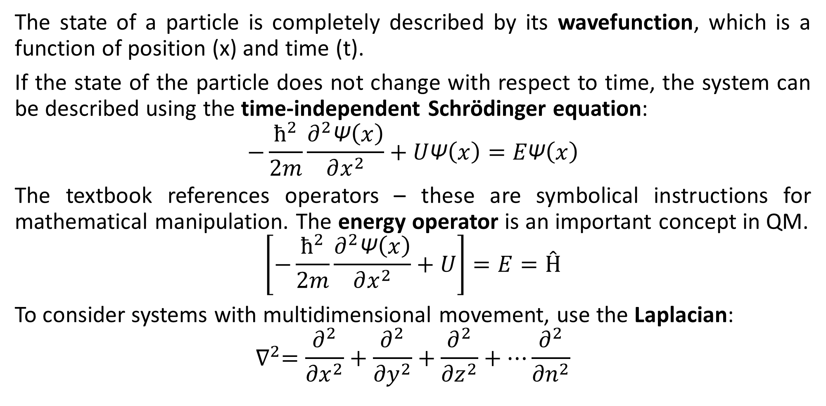
Concept Check
The state of a particle is completely described by its wavefunction, which is a function of position (x) and time (t).
If the state of the particle does not change with respect to time, the system can be described using the time-independent Schrödinger equation:
$$−\frac{ħ^{2}}{2m}\frac{∂^{2}\text{Ψ}\left(x\right)}{∂x^{2}}+U\text{Ψ}\left(x\right)=E\text{Ψ}\left(x\right)$$
The textbook references operators – these are symbolical instructions for mathematical manipulation. The energy operator is an important concept in QM.
$$\left[−\frac{ħ^{2}}{2m}\frac{∂^{2}\text{Ψ}\left(x\right)}{∂x^{2}}+U\right]=E=Ĥ$$
To consider systems with multidimensional movement, use the Laplacian:
$$∇^{2}=\frac{∂^{2}}{{∂x}^{2}}+\frac{∂^{2}}{{∂y}^{2}}+\frac{∂^{2}}{{∂z}^{2}}+…\frac{∂^{2}}{{∂n}^{2}}$$

Slide 4
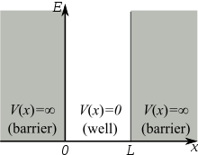
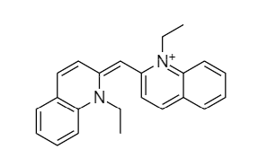

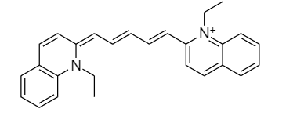
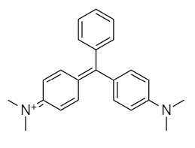


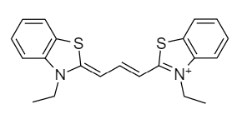
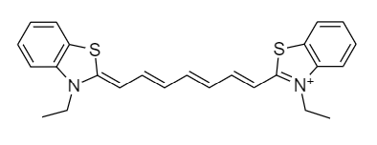
Particle-in-a-Box Examples
The 1D particle-in-a-box model:
Translation of a particle in one dimension
V(x) = 0 to indicate no forces acting upon the particle
V(x) = infinity to set boundary condition
What if the barrier is not infinitely high?
Assessing agreement with the model:
Notes:
These examples are taken from a lab I did in undergrad, which compared lambda-max measurements for each dye to the theoretical value determined by an equation inspired by the particle-in-a-box model. The lesson here is that deviations due to chain length and bond rotations distance the real system from what the model can accurately approximate. In the case of malachite green, there is almost no agreement with the model by virtue of its geometry and lack of polyene linker.

Slide 5
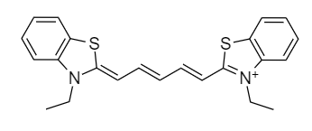
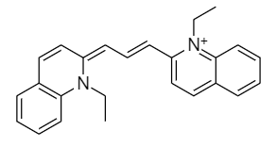
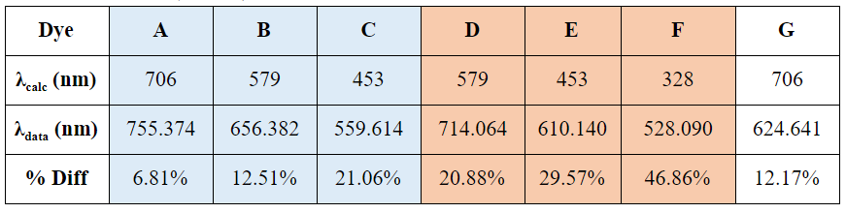
Experimental Data
You will NOT be tested on this information! I just wanted to share data that justify the conclusion made on the previous slide.
A
B
C
G
D
E
F
1D particle-in-a-box model consistently underestimated experimental values in all cases but G
% difference larger for D-F series i.e. “less linear” dyes
Applying a correction factor can account for some of the difference – what explanation do you propose?
Data courtesy of Tram Dao.
Notes:
These examples are taken from a lab I did in undergrad, which compared lambda-max measurements for each dye to the theoretical value determined by an equation inspired by the particle-in-a-box model. The lesson here is that deviations due to chain length and bond rotations distance the real system from what the model can accurately approximate. In the case of malachite green, there is almost no agreement with the model by virtue of its geometry and lack of polyene linker.

Slide 6
Questions?

Slide 7
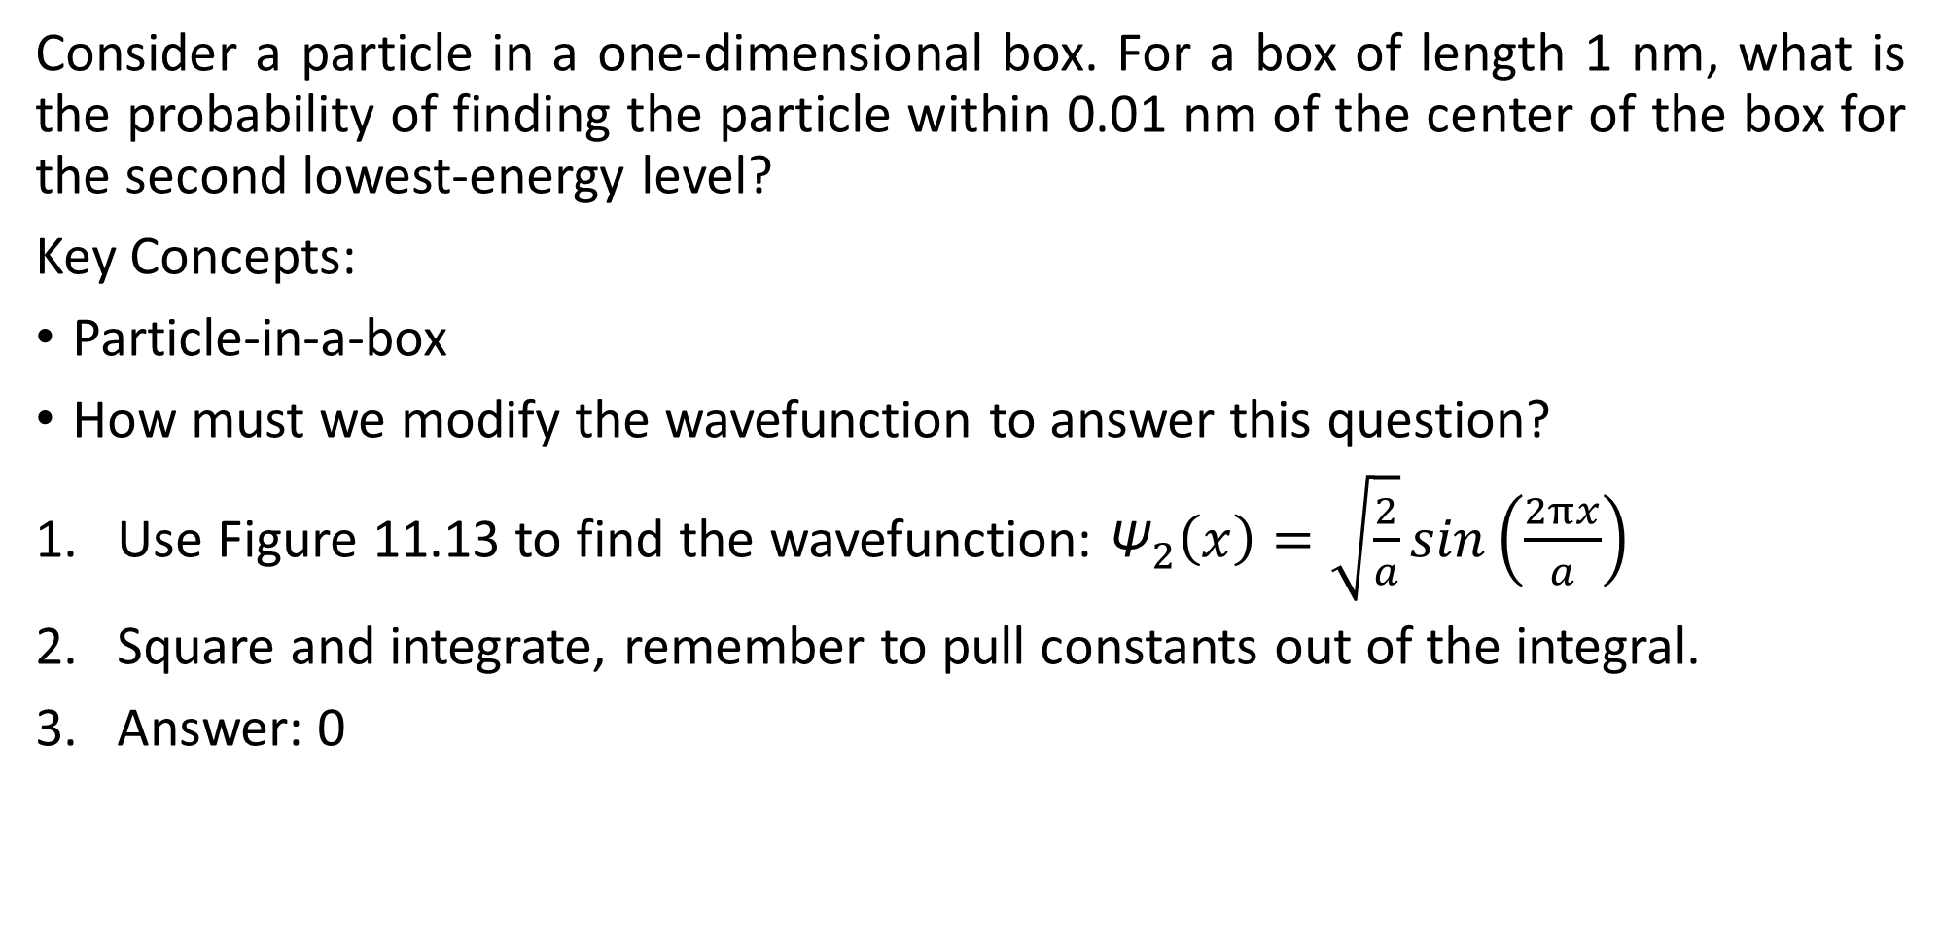
Q1
Consider a particle in a one-dimensional box. For a box of length 1 nm, what is the probability of finding the particle within 0.01 nm of the center of the box for the second lowest-energy level?
Key Concepts:
Particle-in-a-box
How must we modify the wavefunction to answer this question?
Use Figure 11.13 to find the wavefunction: ${\text{Ψ}}_{2}\left(x\right)=\sqrt{\frac{2}{a}}sin\left(\frac{2πx}{a}\right)$
Square and integrate, remember to pull constants out of the integral.
Answer: 0

Slide 8
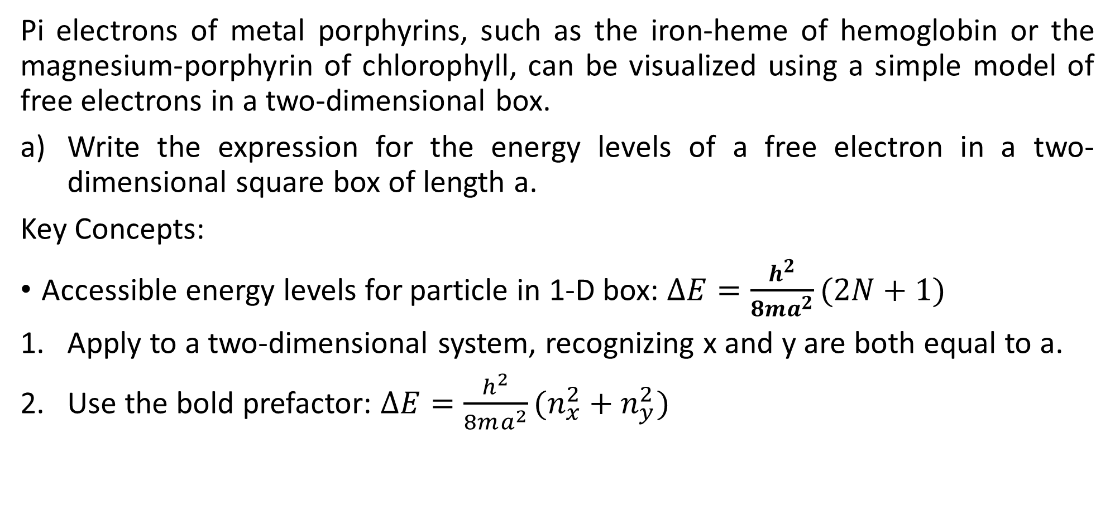
Q2
Pi electrons of metal porphyrins, such as the iron-heme of hemoglobin or the magnesium-porphyrin of chlorophyll, can be visualized using a simple model of free electrons in a two-dimensional box.
Write the expression for the energy levels of a free electron in a two-dimensional square box of length a.
Key Concepts:
Accessible energy levels for particle in 1-D box: $∆E=\frac{h^{2}}{8ma^{2}}(2N+1)$
Apply to a two-dimensional system, recognizing x and y are both equal to a.
Use the bold prefactor: $∆E=\frac{h^{2}}{8ma^{2}}(n_{x}^{2}+n_{y}^{2})$

Slide 9
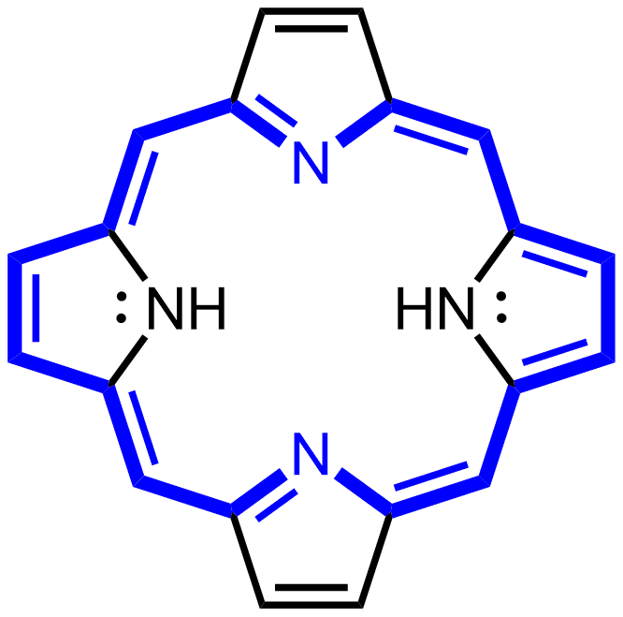
Q2 cont.
b) Sketch an energy-level diagram for this problem. Set E₀ = h²/8ma² and label the energy of each level in units of E₀.
Count the pi electrons in the conjugated system.
Create “pairs” of x and y energy levels, arrange by energy.
E₃₄ = E₄₃ = 25E₀
E₂₄ = E₄₂ = 20E₀
E₃₃ = 18E₀
E₁₄ = E₄₁ = 17E₀
This approach also answers part c, though the limit of 2 e⁻ per pi orbital should keep you from making useless calculations.
E
E₂₃ = E₃₂ = 13E₀
E₁₃ = E₃₁ = 10E₀
E₂₂ = 8E₀
E₁₂ = E₂₁ = 5E₀
E₁₁ = h²/8ma² (1+1) = 2E₀
E₀
Notes:
NOT TO SCALE

Slide 10
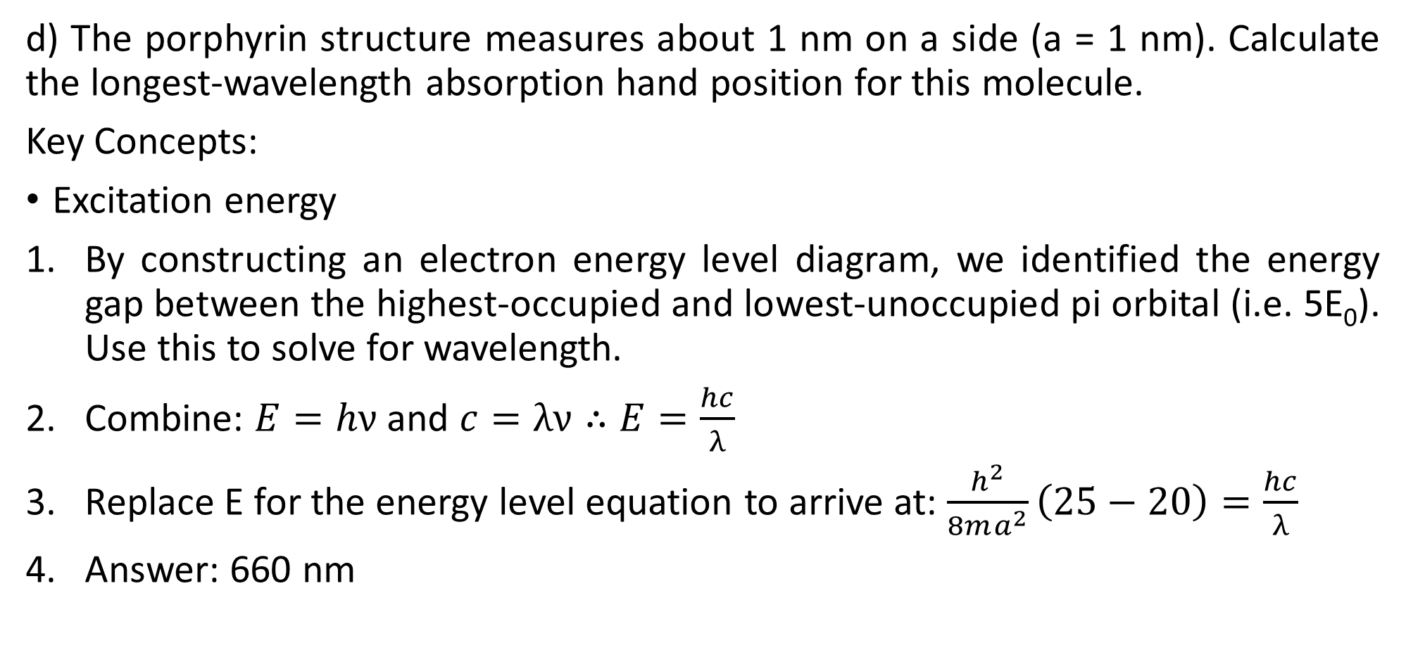
Q2 cont.
d) The porphyrin structure measures about 1 nm on a side (a = 1 nm). Calculate the longest-wavelength absorption hand position for this molecule.
Key Concepts:
Excitation energy
By constructing an electron energy level diagram, we identified the energy gap between the highest-occupied and lowest-unoccupied pi orbital (i.e. 5E₀). Use this to solve for wavelength.
Combine: $E=hν$ and $c=λν∴E=\frac{hc}{λ}$
Replace E for the energy level equation to arrive at: $\frac{h^{2}}{8ma^{2}}\left(25−20\right)=\frac{hc}{λ}$
Answer: 660 nm

Slide 11
Questions?
Have a good weekend!

